Slide 1
Arrays in Java Lecture - 10
Prepared By - Rupali Patil

Slide 2
Contents
Passing arrays to a functions
Jagged arrays

Slide 3
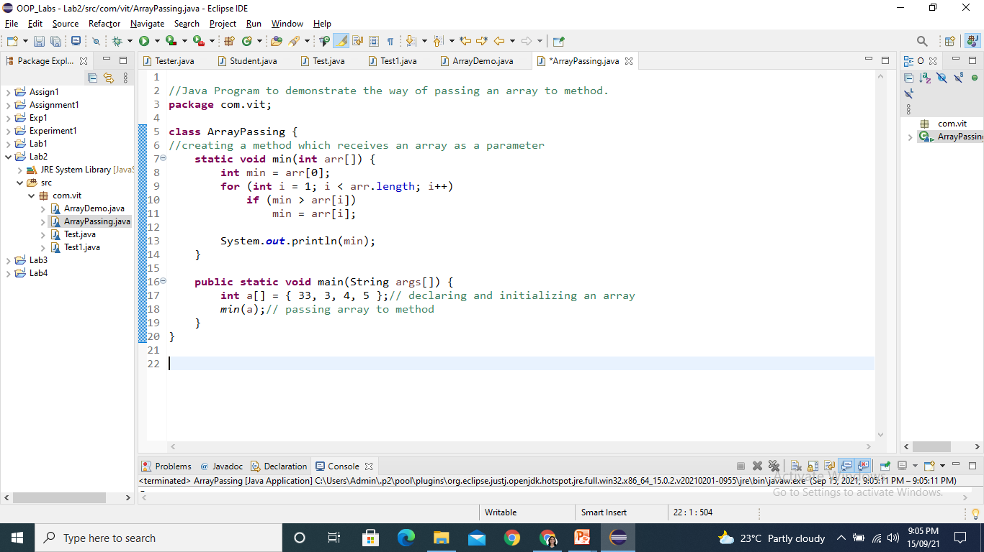
Passing arrays to a functions
Arrays are always passed by reference in java.
Arrays are passed to functions just like ordinary variable passing.

Slide 4
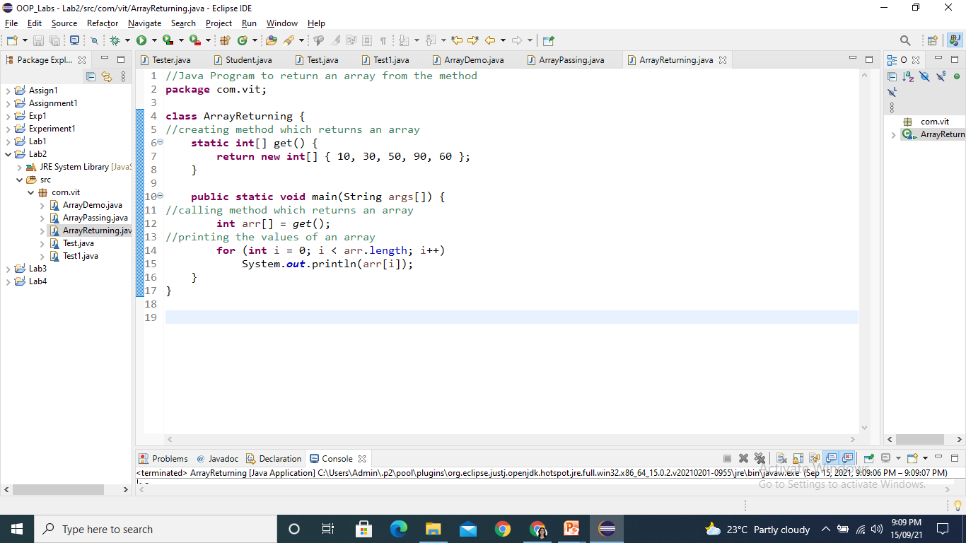
Returning arrays from a functions

Slide 5
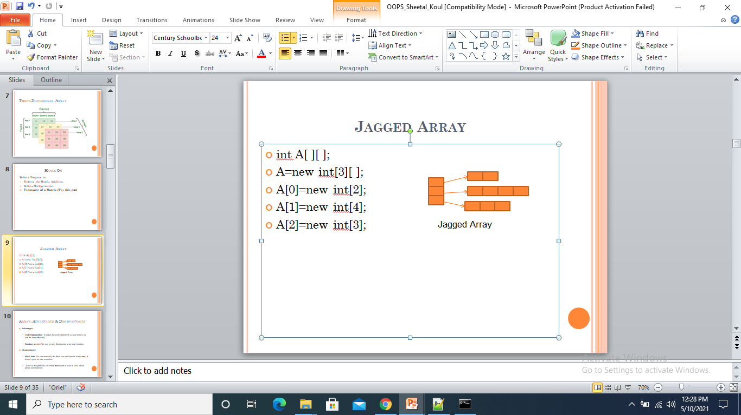
Jagged arrays
A jagged array is an array of arrays such that member arrays can be of different sizes.

Slide 6
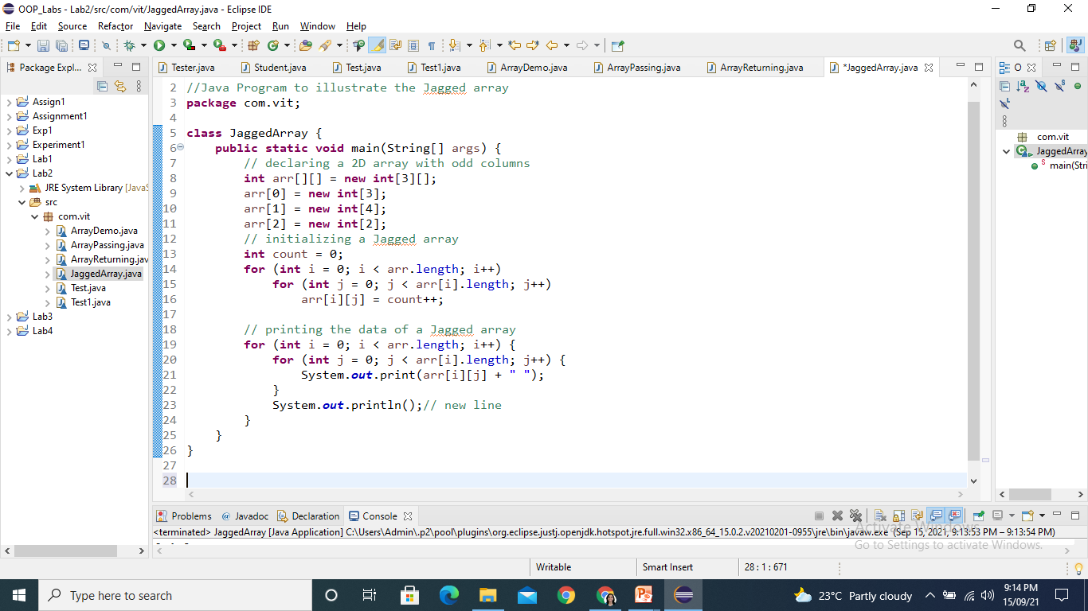
Jagged Array contd..

Slide 7
Array Advantages and Disadvantages
Advantages:
Code Optimization: It makes the code optimized, we can retrieve or sort the data efficiently.
Random access: We can get any data located at an index position
Disadvantages:
Size Limit: We can store only the fixed size of elements in the array. It doesn't grow its size at runtime.
To solve this problem, collection framework is used in Java which grows automatically.

Slide 8
Thank You

